Slide 1
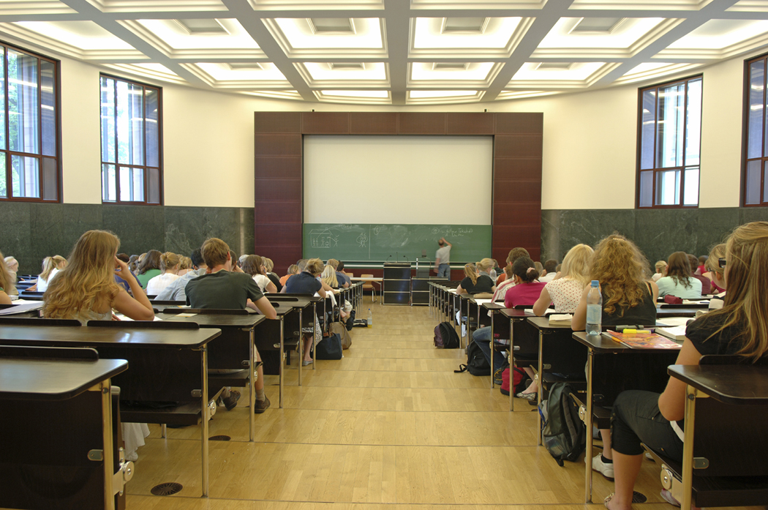
Determining how many units to take each semester
Full time?
Part time?
Working?

Slide 2
1=2
For every ONE HOUR spent in class…
…you should expect to spend TWO HOURS studying and completing assignments outside of class

Slide 3
Example: HIST B17a History of the United States
3 units
For every unit, expect to spend one
hour in class per week
MW 11:10am-12:35pm
R 6:00pm-9:10pm

Slide 4
Total hours spent on HIST B17a per week
3 hours per week in class
6 hours outside of class
9
One 3 unit class will take up 9 hours per week!

Slide 5
Full time STUDENT ( 12+ units)
12 hours in class
24 hours studying
36
A total of 36 hours per week spent on school! That’s equivalent to a full time job!

Slide 6
Full time student & full time job
If you work 35-40 hours per week and take a full load of classes (12 units), you will be ‘working’ for a total of 71-76 hours per week! (And that’s not including your personal life – family, friends, ‘you’ time, etc.)

