Slide 1
Welcome to STDV B1 Bakersfield College
Spring 2014

Slide 2
Students Requiring Special Accommodations
If you have a disability and are in need of an accommodation, please contact the DSPS (Disabled Students Program and Services). Office located in the Student Services Building or call 395-4334 for assistance.
The DSPS Office and services are also available at the Delano Campus/Admissions & Records Building. Call 661-720-2000.

Slide 3
Steps for New Students
Admission
Orientation
Assessment
Counseling
Student Development course/Educational Planning

Slide 4
Course Selections
Student Development
STDV B1
STDV B2
STDV B4
STDV B6
Educational Planning classes specific to majors:
ARCH B1 AGRI B1 INDT B10
ENGR B47 FDSV B50 NURS B100
BSAD B20 EDUC B24

Slide 5
Course Selection
Basic Skills
Student Development
Other Educational Planning classes specific to majors
General Education
Major specific coureses (require “C” grade)
CAUTION: Engineering, Architecture students planning to transfer need to concentrate on major classes. Refer to www.assist.org
Electives

Slide 6
Graduation Requirements
Completition of 60 degree applicable units
Major – Classes require “C” grades minimum
AA-T and AA-S
General Education
Electives
Three general education patterns:
Bakersfield College (BC)
California State University (CSU)
Intersegmental General Education Transfer Curriculum (IGETC)
(Refer to graduation and general education in the BC catalog)

Slide 7
BC offers certificates in 22 areas
Some examples of areas are:
Fire EMTC
Child Development Industrial Technology
Nurse Assistant (CNA) Architecture
Human Services Digital Arts
Auto Food Service
Communication Agriculture
Welding Construction
Manufacturing Computer Studies
Woodworking Business

Slide 8
Developing Your Student Ed Plan
Basic Skills courses
English and Math courses
Student Development course
General Education courses
Major courses

Slide 9
Steps to Prepare for Online Registration
New Students register on the first day of open registration (refer to Important Dates on BC website) under class schedule page http://www.bakersfieldcollege.edu/academic/schedule
Your Bakersfield College ID is either your Social Security Number or the @00…… assigned to you by the computer when you began.
Your PIN is the one you created on your admission form

Slide 10
College 101
2 – 16 week semesters
Summer sessions
Unit – One hour of class instruction
Prerequisite – see course description
Full time enrollment = 12 units or more
Drop/Withdrawal Dates
Online or hybrid
Good Standing requires grade point average of 2.0
Probation
Academic
Progress
Disqualification
Course Syllabus

Slide 11
Remember: It is now your responsibility to
Know important dates http://www.bakersfieldcollege.edu
Attend class
First day drop policy
Waitlist, must be present first day
Be prepared to learn

Slide 12
To be successful, you need to
Know where your classes are located
Buy your books early at the BC Bookstore or go to the BC homepage, click on Student Services, click on Bookstore.
Be on time for classes
Be prepared (pens/pencils, binders/paper/planner
Manage your time
Purchase a Daily Planner
SGA Planning semester calendar

Slide 13
Successful Students
Study two hours for evey one hour of class
Mnake sure you understand assignments before you start
ASK FOR HELP early in the semester
Seek instructor’s help during office hours
Seek tutoring
Form study groups with classmates
Use the college library
Speak with a counselor or advisor

Slide 14
Successful students also
Know their BC ID number @00……
Know their PIN number
Know their BC email account and check it regularly OR have that account forwarded to another email
Complete updates every semester before registration begins
Register on their priority registration date (see BC website for date)

Slide 16
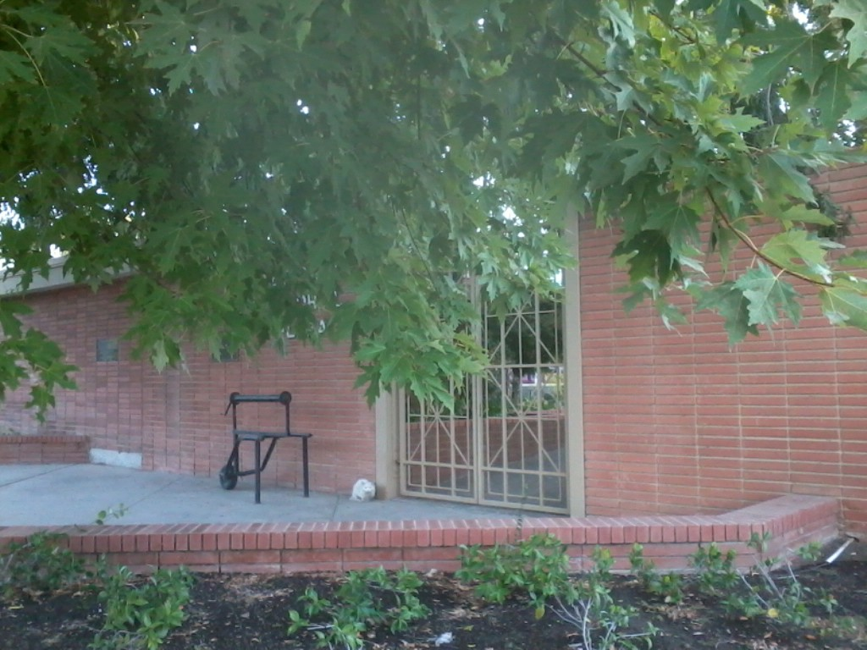

Slide 17
