Slide 1
True Colors
BLUE
GOLD
ORANGE
GREEN

Slide 2
Follow Your True Colors to the Work You Love
Risk taker
Values adventure and change
Loves to be where the action is
Go for it!
Leader and Intellect
Values their independence and ability to learn
Loves a challenge
Knowledge is power!
Seek to love and be loved
Value Peace and Harmony
Loves to inspire and support
To thine own self be true
Plan it
Values Order and Tradition
An Organizer and Planner
Early to bed, Early to Rise

Slide 3
BLUE
Nurturer and Supporter
Teacher, Social Worker, Waitress, or Nurse.
Prefers a friendly and warm work environment.
Creative work style, enjoying variety in their day-to-day interactions.

Slide 4
GOLD
Planner and organizer.
Tax examiner, banker administrator, secretary, or construction worker.
Prefers a structured environment with clear lines of authority.
Their work style is thorough, punctual and efficient.

Slide 5
GREEN
A Natural leader and intellect.
Scientist, engineer, business manager, college instructor, play writer, web developer.
Prefers a challenging, independent work environment.
Their work style is that of an innovative problem solvers.

Slide 6
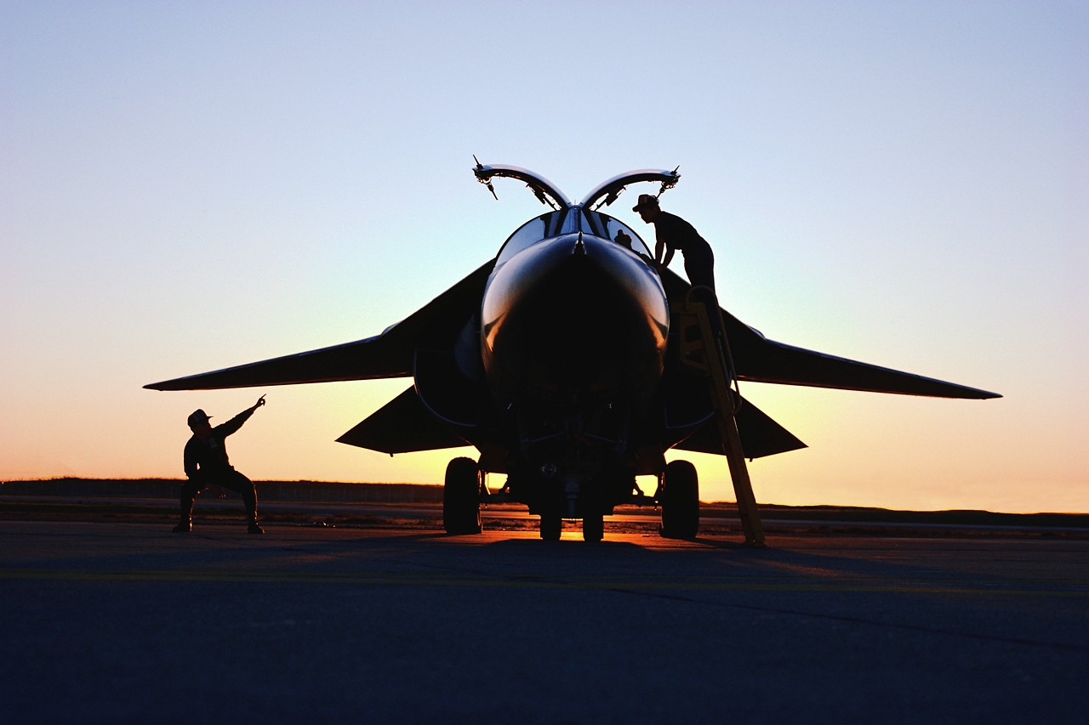
ORANGE
A SEEKER OF ADVENTURE!
PILOT, ACTOR, POLICE OFFICER, REAL-ESTATE AGENT, MUSICIAN
PREFERS A DEMANDING WORK ENVIRONMENT WHERE THEY CAN HIGHLIGHT THEIR TALENTS.
ACTION-ORIENTED WORK STYLE PREFERRING HANDS-ON WORK.

Slide 7
THE WORLD
Blue
Seeks to understand people
Gold
Seeks to maintain and organize the world.
Green
Seeks to understand how the world works.
Orange
Seek to explore the world.

Slide 8
If you were going into law which area would you choose?
Family
Trial
Tax
Contract

Slide 9
If you were going into the food industry what area would you choose?
Trainer
Chef
Restaurant Manager
Food Scientist

Slide 10
Which color is represented in each row?
STRENGTHS | JOYS | NEEDS | STESSORS
KINDNESS | FAMILY | PEACE | MEAN PEOPLE
REASONING | FAMILY TIME | SECURITY | NO RULES
LOGICAL | INNOVATION | INTELLECTUAL CHALLENGES | LOSS OF CONTROL
BOLDNESS | ADVENTURE | ACTION | ROUTINE

Slide 11
Can you guess their colors?
Bill Clinton
Mr. Rogers
Einstein
Steven
Spielberg
Dan Rather

Slide 12
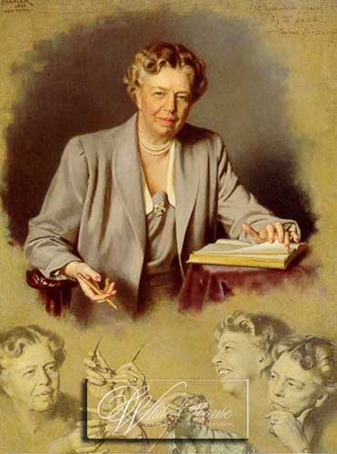
The future belongs to those who believe in their dreams.
Eleanor Roosevelt

