Slide 1
True Colors
BLUE
GOLD
ORANGE
GREEN

Slide 2
THE WORLD
Blue
Seeks to understand people
Gold
Seeks to maintain and organize the world.
Green
Seeks to understand how the world works.
Orange
Seek to explore the world.

Slide 3
Follow Your True Colors to the Work You Love
Risk taker
Loves to be where the action is
Go for it!
Knowledge is power
Point 2
Seek to love and be loved
Value Peace and Harmony
Wear your heart on your sleeve
To thine own self be true
Plan it
An Organizer and Planner
Early to bed, Early to Rise

Slide 4
If you were going into law which area would you choose?
Family
Trial
Tax
Contract

Slide 5
If you were going into the food industry what area would you choose?
Trainer
Chef
Restaurant Manager
Food Scientist

Slide 6
Which color is represented in each row?
STRENGTHS | JOYS | NEEDS | STESSORS
KINDNESS | FAMILY | PEACE | MEAN PEOPLE
REASONING | FAMILY TIME | SECURITY | NO RULES
LOGICAL | INNOVATION | INTELLECTUAL CHALLENGES | LOSS OF CONTROL
BOLDNESS | ADVENTURE | ACTION | ROUTINE

Slide 7
Can you guess their colors?
Bill Clinton
Mr. Rogers
Einstein
Steven
Spielberg
Dan Rather

Slide 8
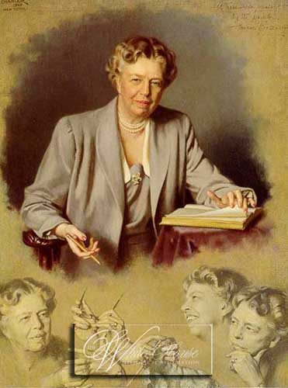
The future belongs to those who believe in their dreams. Eleanor Roosevelt

