Slide 1
O*NET and Personality Mosaic Codes
Deciphering a good match for your occupation based on Holland’s Personality RIASEC Codes
By Jenny Peters

Slide 2
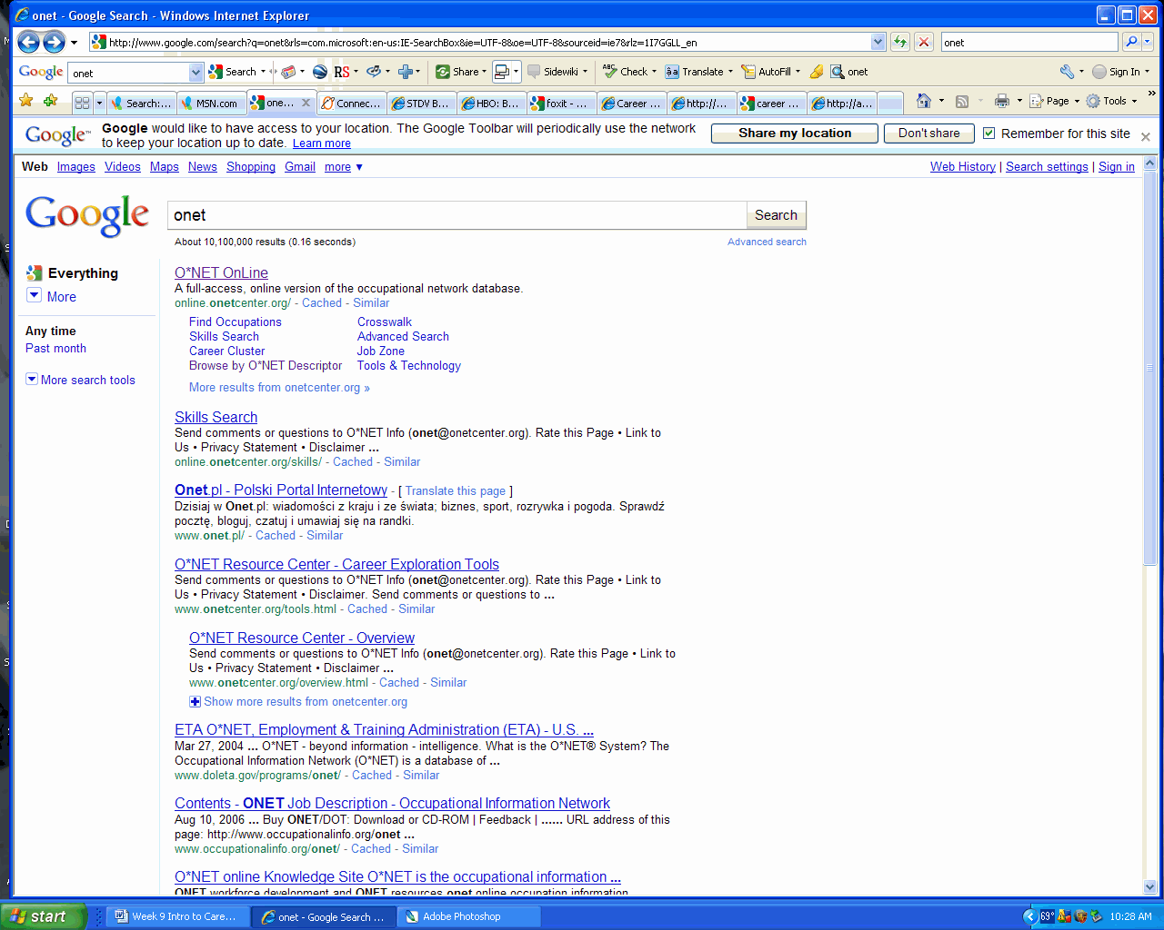

Slide 3
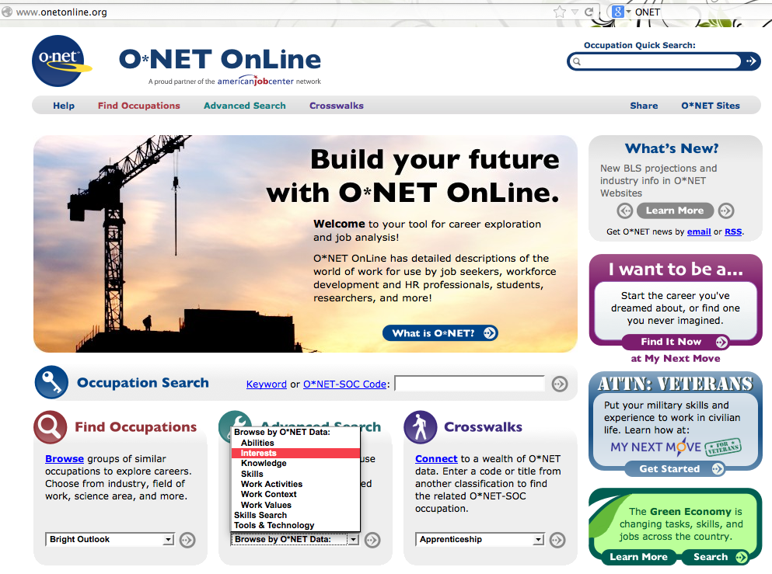

Slide 5
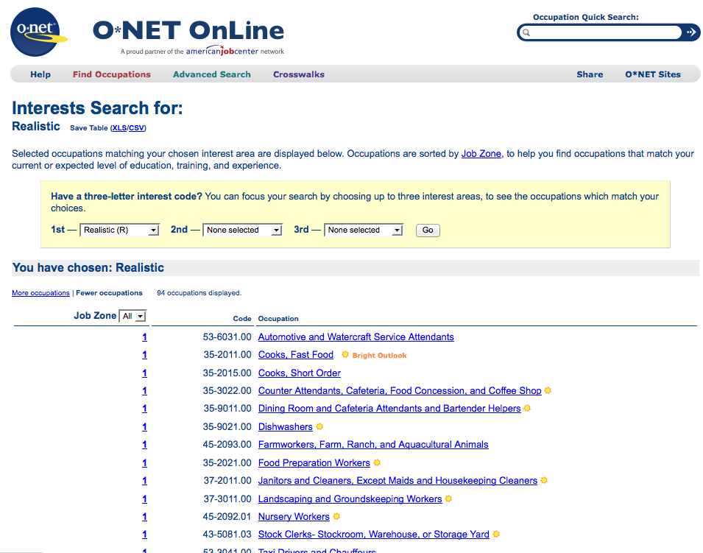

Slide 6
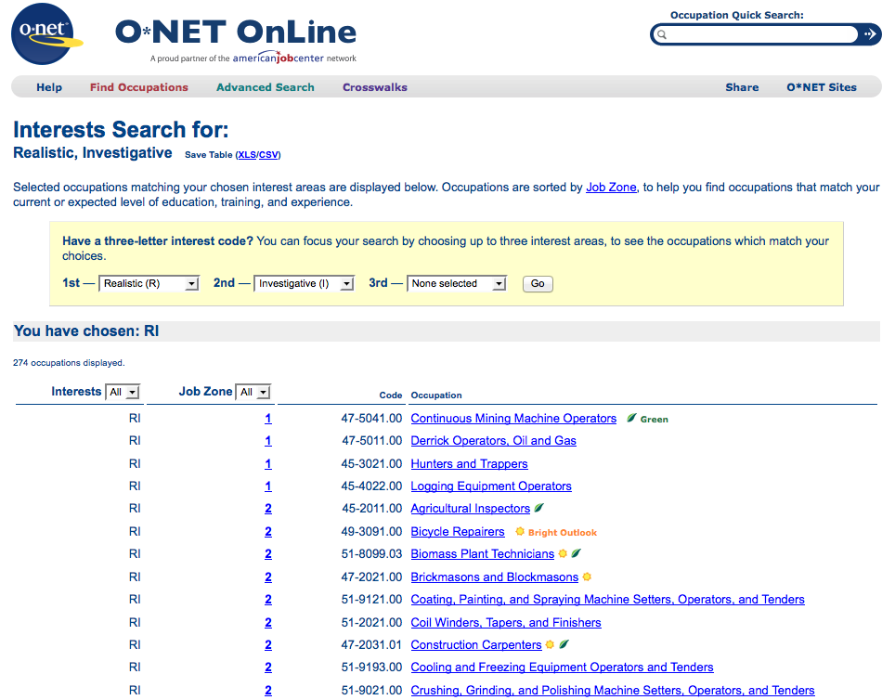

Slide 8
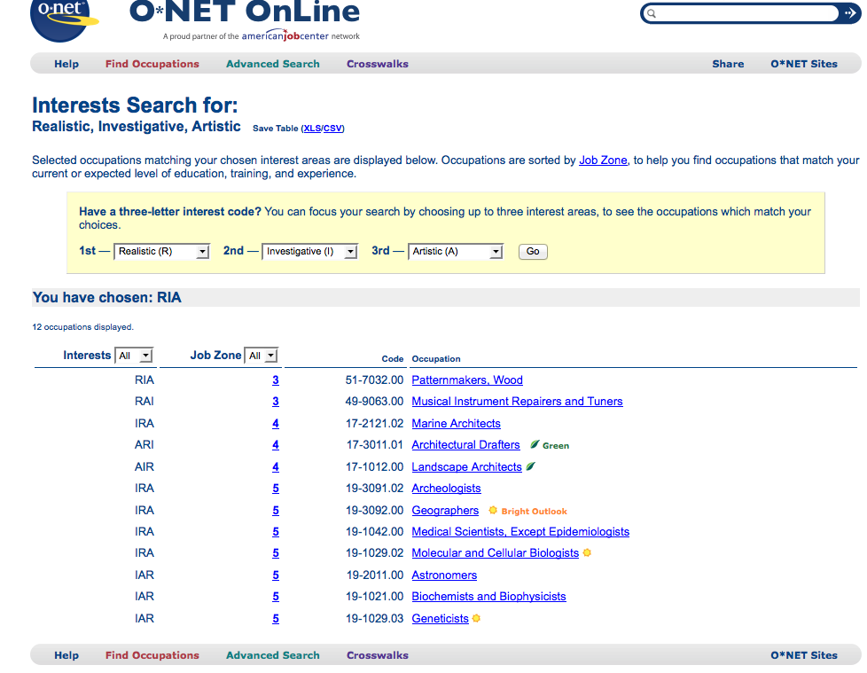

Slide 9
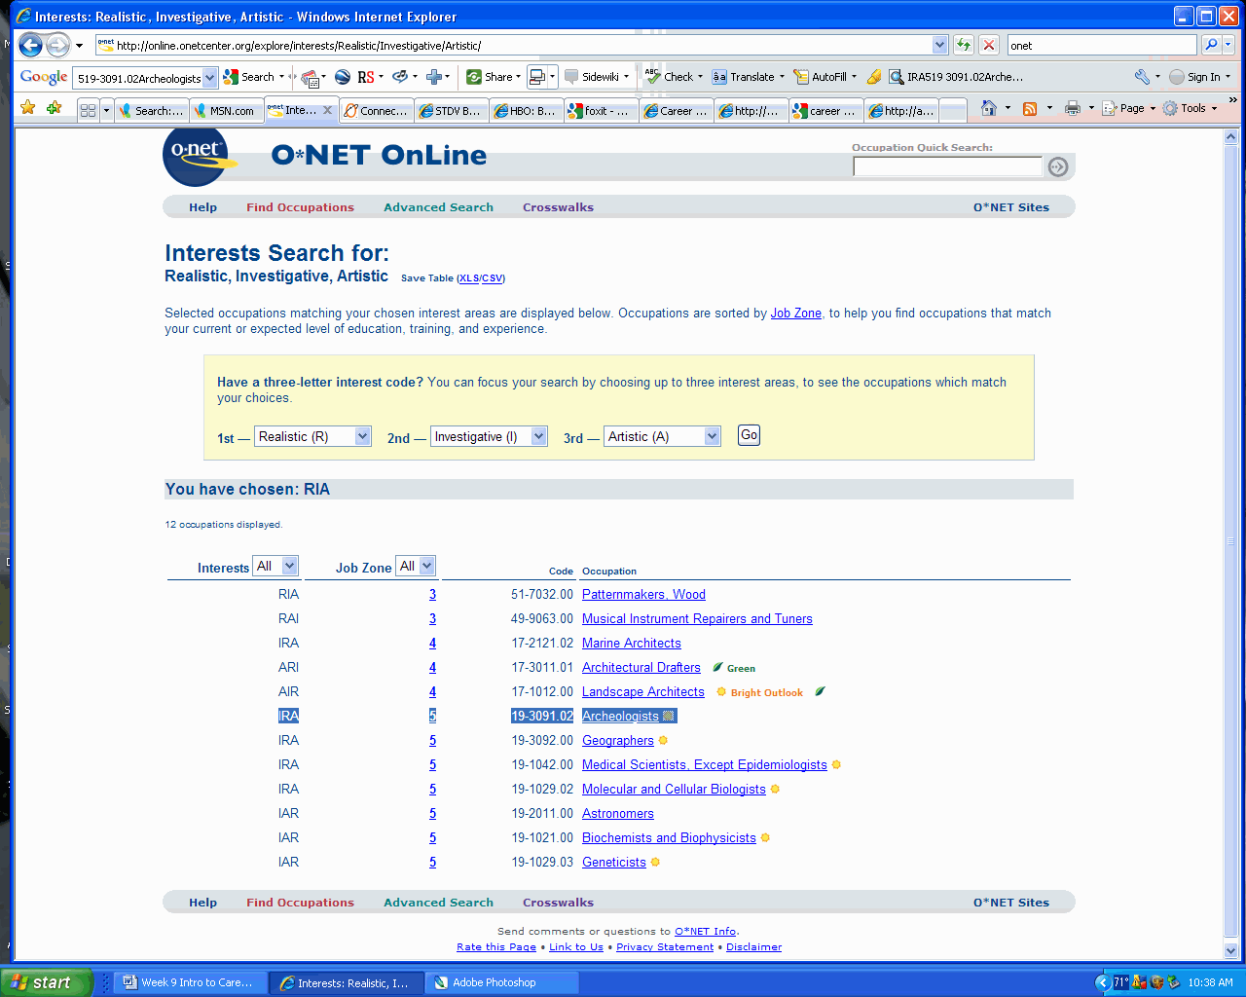

Slide 10
