Slide 1
Mind Mapping

Slide 2
What is mind mapping?
A diagram to represent words, ideas, tasks, or other items arranged around a central key word or idea

Slide 3
How are Mind Maps used?
Mind maps are used to generate, visualize, structure, and classify ideas. Mind maps are used as a study aid, to organize information, to problem solve, to make decisions, and to write essays.

Slide 4
How do I arrange elements?
Elements are arranged intuitively
Concepts are classified into groups, branches or areas
Ideas are presented in a radial, graphical, non-linear manner

Slide 5
What materials can I use?
Markers
Pens
Crayons
Colors
Images
Magazines
Internet
Original photos

Slide 6
Where do I begin?
Choose multiple colors for visual stimulation
Each word or image is best alone and sitting on its own line
Use images, symbols, codes, lines
Lines should be connected starting from the central image
Begin with a word or image of YOU

Slide 7
How do I start?
Start in the center with an image of the topic: You
Use at least 3 colors
Pre-map what your goals are
Add goals as they arise
Associate prior goals to new ideas

Slide 8
What else am I mapping?
Your goals!
Career
Educational
Family
Financial
Physical
Public service
Social
Enjoyment
Artistic
Other

Slide 9
May I see samples?
Yes!

Slide 10
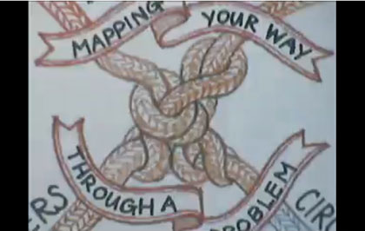
Problem Solving Mind Map
Prewrite ideas and fill in gaps

Slide 11
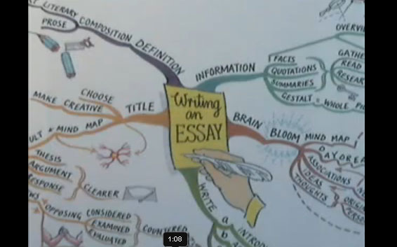
Essay Mind Map
Use branches to brainstorm

Slide 12
Language Mind Map
Outline and condense material

Slide 13
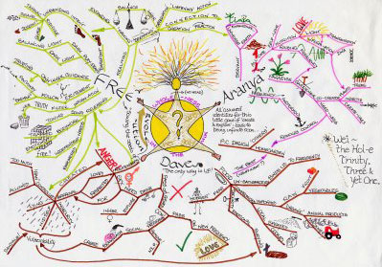
Guru Mind Map
Lots of color around a central theme

Slide 14
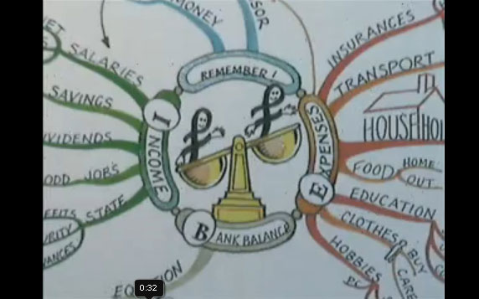
Numbers Mind Map
Add numbers to branches

Slide 15
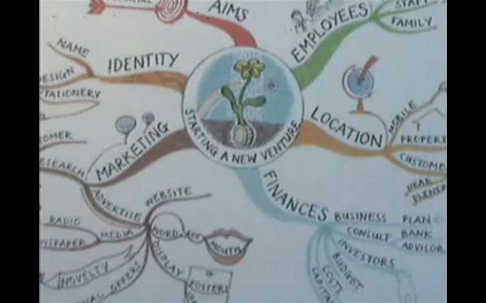
Goal Mind Map
Map out dreams and connect paths

Slide 16
Visual Mind Map
My goals
Creativity
Expression

Slide 17
Mind mapping video
How to make a mind map video
http://www.youtube.com/watch?v=v8_H42Z9wxA&feature=fvw
Wikipedia explanation
http://en.wikipedia.org/wiki/Mind_map
Learn how to use Mind Maps for Note Taking (2:51 min) http://www.youtube.com/watch?v=x4Rz5nQppps&feature=related

