Slide 1
Financial Aid
2010
Jenny Peters

Slide 2
Do I qualify for financial aid?
Apply
Pell Grant
SEOG
CARE
BOGFW
Cal Grants A, B, C
Work Study
EOP&S

Slide 3
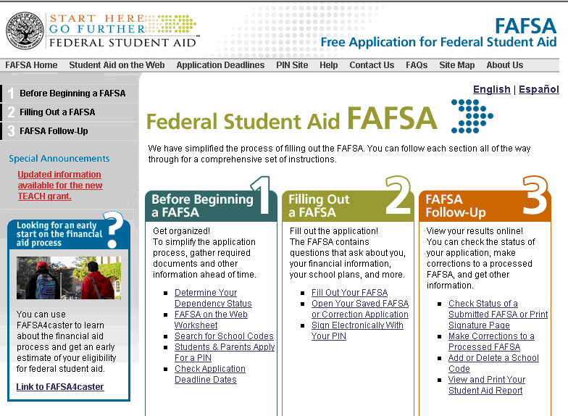
How to apply
http://www.fafsa.ed.gov

Slide 4
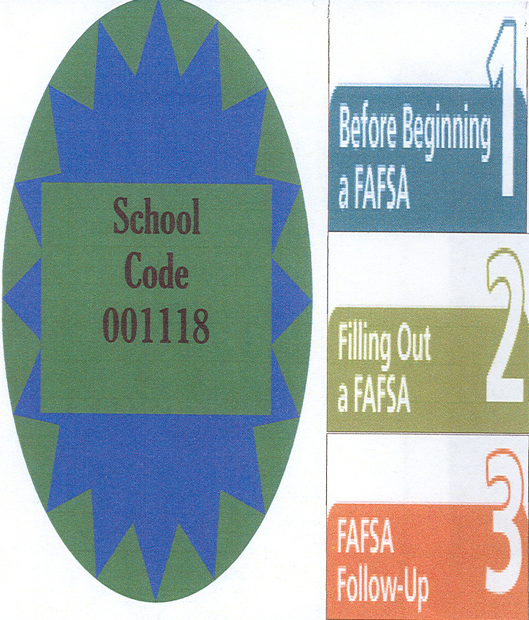
Apply now for 2010-2011
Apply for a FAFSA PIN number at: http://www.pin.ed.gov
Complete the FAFSA at http://www.fafsa.ed.gov
Check status online and go to the Financial Aid Office

Slide 5
Process
It takes 3-4 months to process FAFSA
FAFSA PIN versus BC PIN
Save money for books
SAR

Slide 6
Financial Aid Changes
Shorter application
Less information required
Easier online process

Slide 7
Financial Aid Probation
Withdrawal from college – pay back
70% rule
Appeal

Slide 8
Financial Aid Advisors
7:30 – 4:30 Monday -Thursday
8:00 – 11:00 Friday
What to bring:
All income tax information (or parent’s info)
Federal Tax return or W’2’s (if you are not required to file taxes)
Alien Registration number
Your FAFSA PIN number

Slide 9
Gades Card
Student photo ID
Print card for Library or Career Center
$15 sticker supports the Student Government Association leadership (SGA) is optional. The sticker fee does provides:
5% discount at bookstore
4 Free Basketball game tickets
One free legal advise at Chain and Younger
Other discounts around town

Slide 10
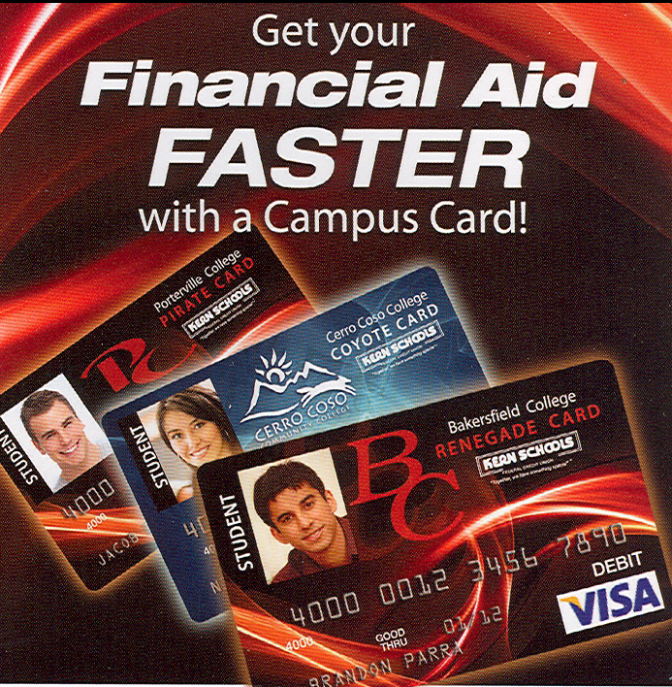
Campus Card
Apply at Kern Schools
Student ID
Library Card
ATM/Debit Card
Add money to print

