Slide 1
COMPREHENSIVE STUDENT EDUCATION PLAN
BY JENNIFER PETERS FALL 2014
PPT Design by Aricia Leighton

Slide 2
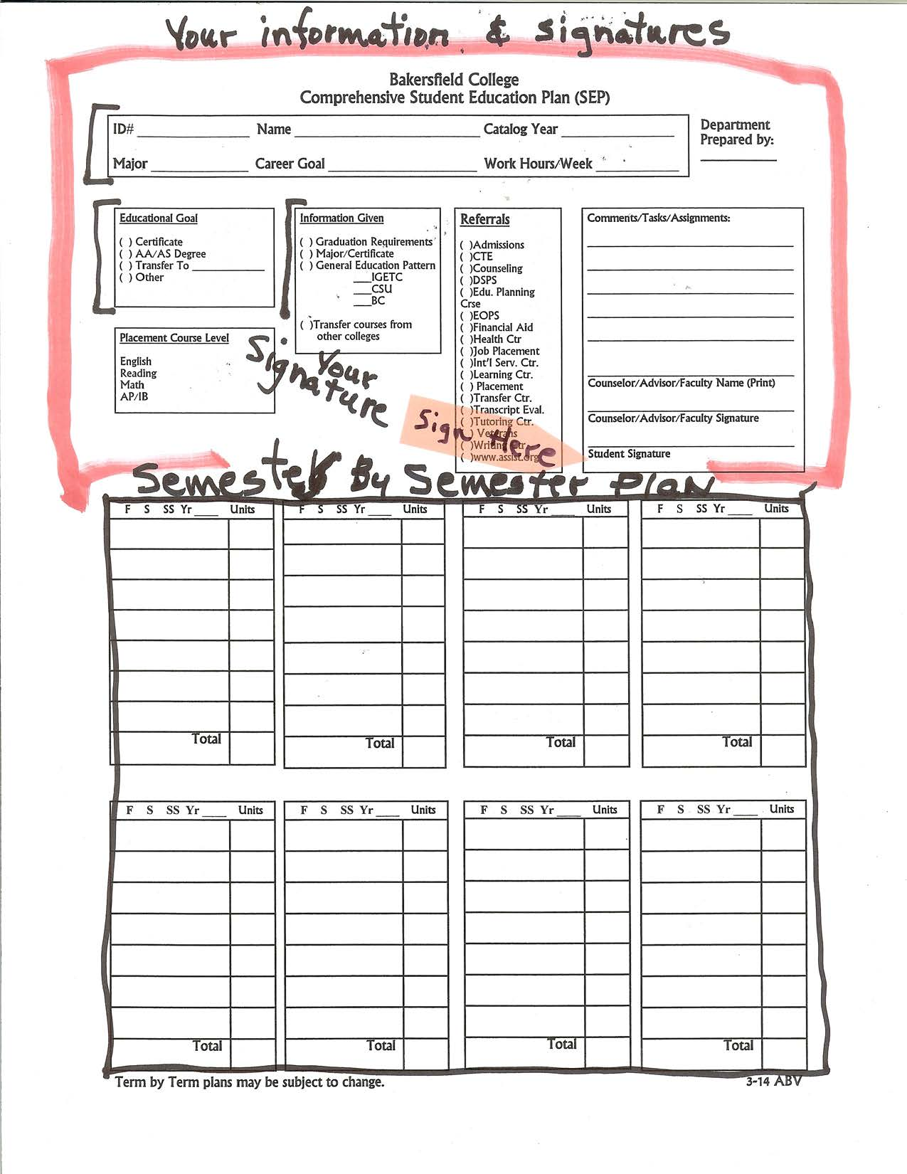

Slide 3
Top of page 1
First Box
Educational Goal
Information given
Make sure to Sign

Slide 4
Semester by semester plan
Complete after mapping your SEP

Slide 5
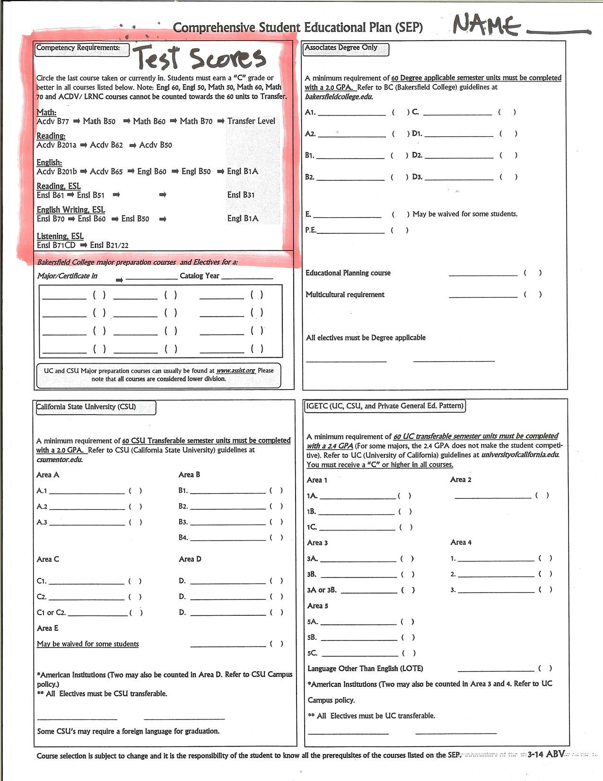
Obtain your test scores from Assessment. Circle where you placed in English, Reading and Math.

Slide 6
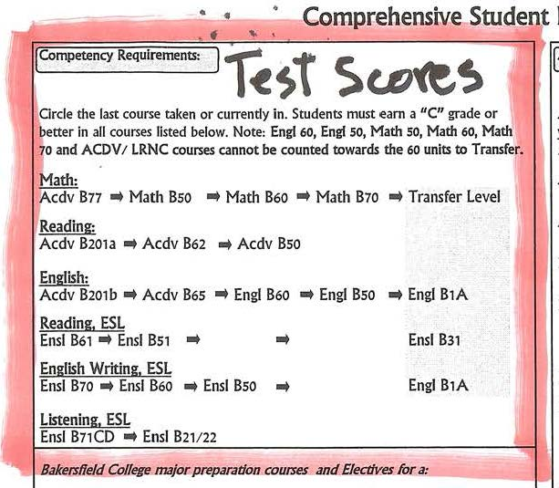
Test scores
Circle the first course taken or currently enrolled. Notice the progression from left to right for basic skills

Slide 7
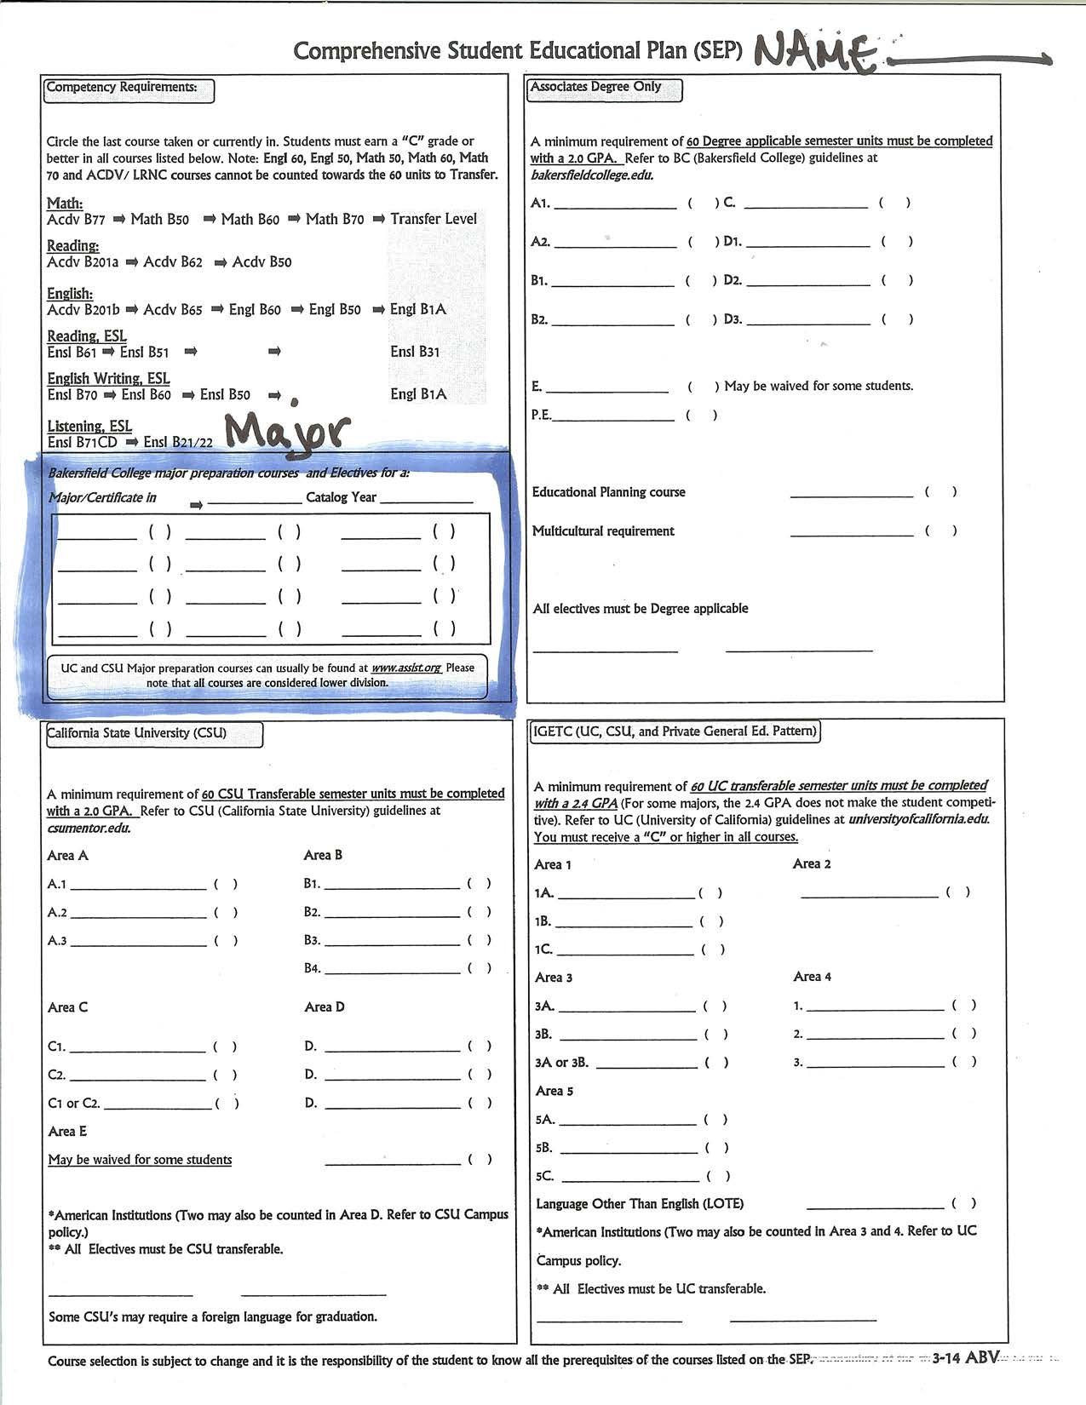
Go to your catalog or BC website> Programs> Degrees & Certificates to list your major requirements

Slide 8
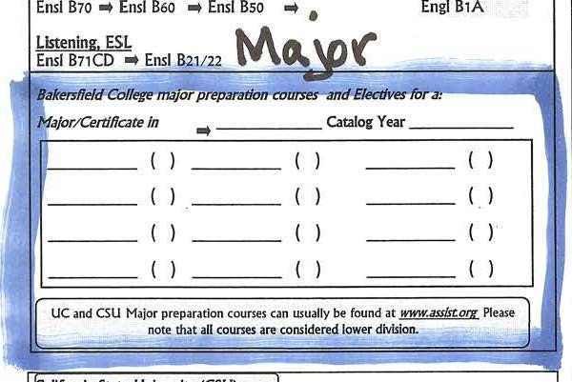
Major
Write in your major. Fill in classes that will prepare you for the major at BC without transfer, , or use ASSIST .org for UC and CSU major preparation to transfer.

Slide 9
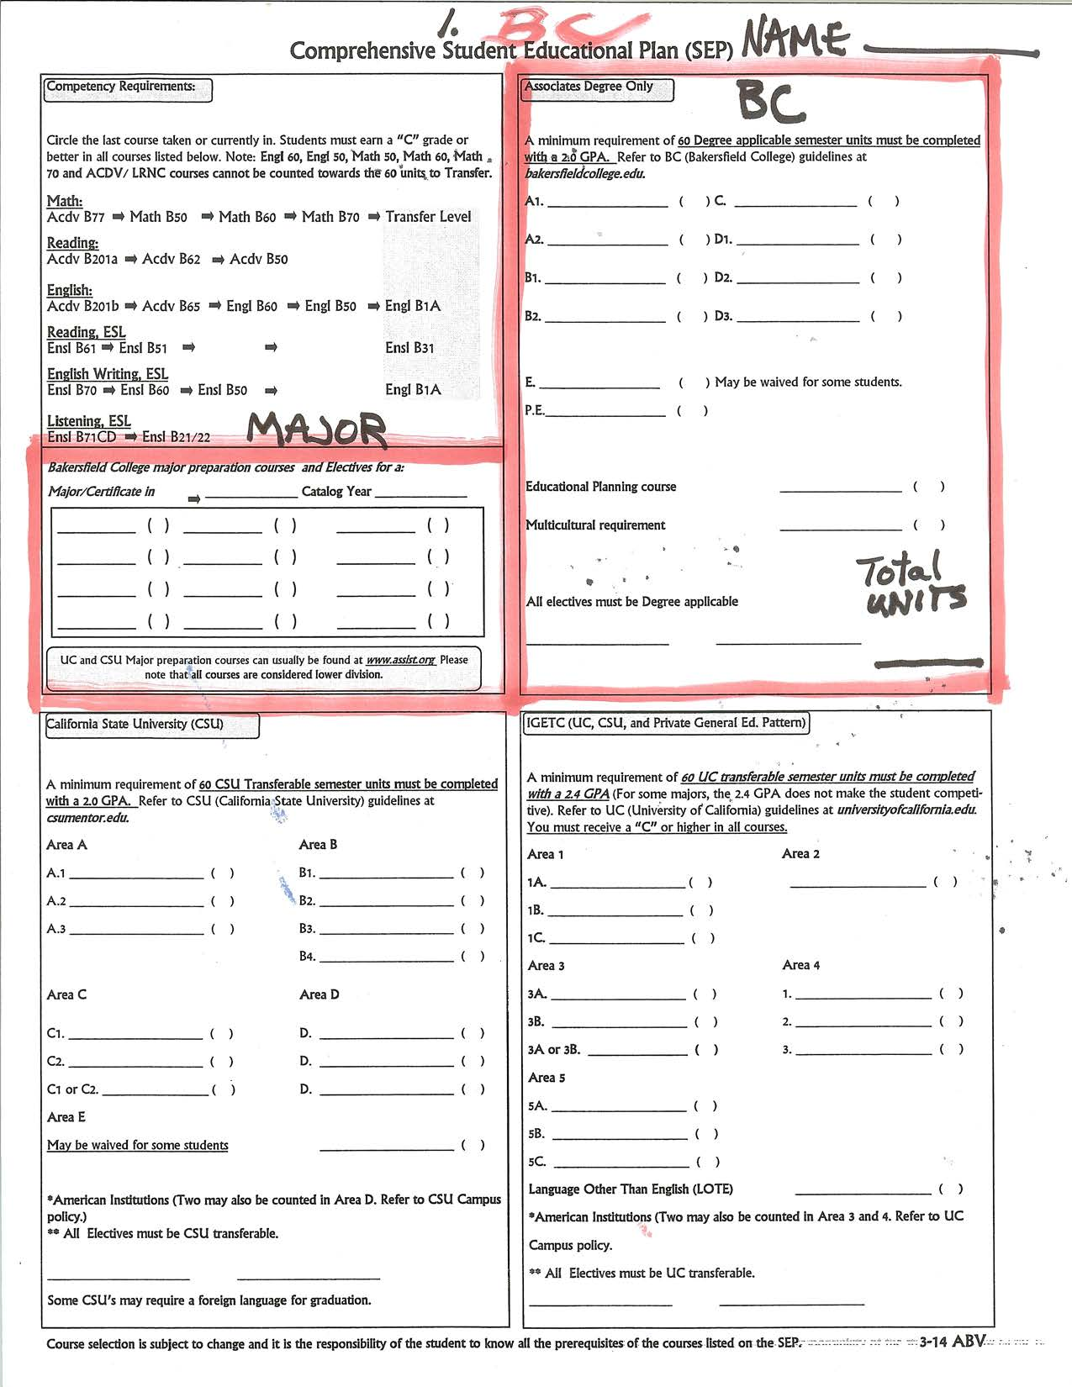

Slide 10
Major or Certificate at BC
Fill in the Major Box with courses to graduate with the major you intend. Use the Catalog for certificate and AA information.

Slide 11
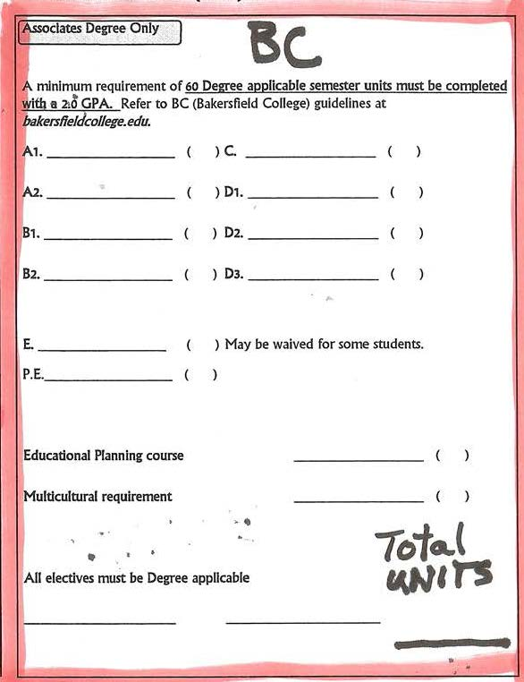
AA Degree Only
List degree applicable classes for general education using the BC pattern.
See catalog for required classes for your major.
Write in Total Units

Slide 12
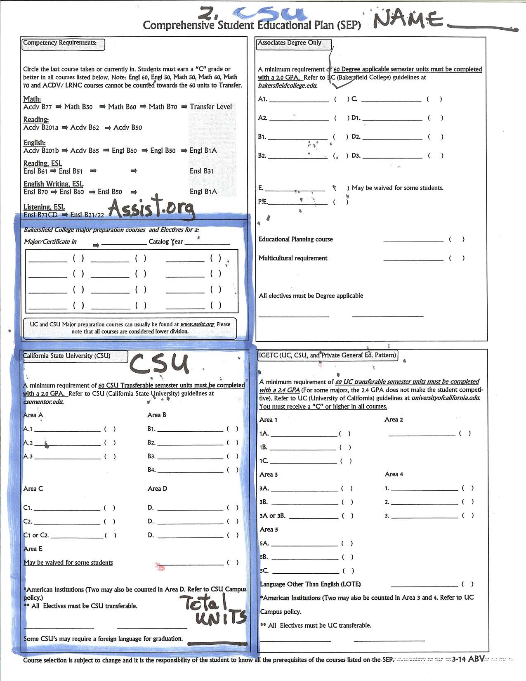
SEP Page 2 for transferring to a CSU

Slide 13
transfer to csu
Two boxes to fill out for CSU transfer.
Assist
CSU
Total Units

Slide 14
The Assist Box
Use Assist to fill in your classes
Don’t forget to write in catalog year
BC may not offer your goal major!

Slide 15
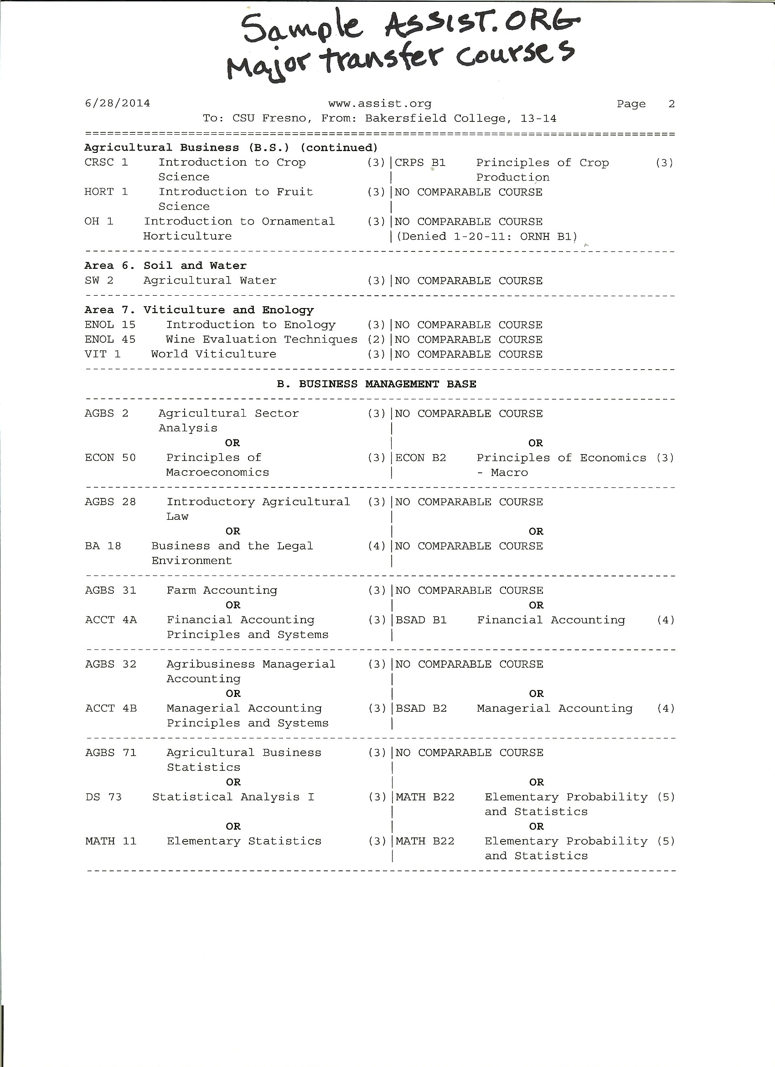
Using assit

Slide 16
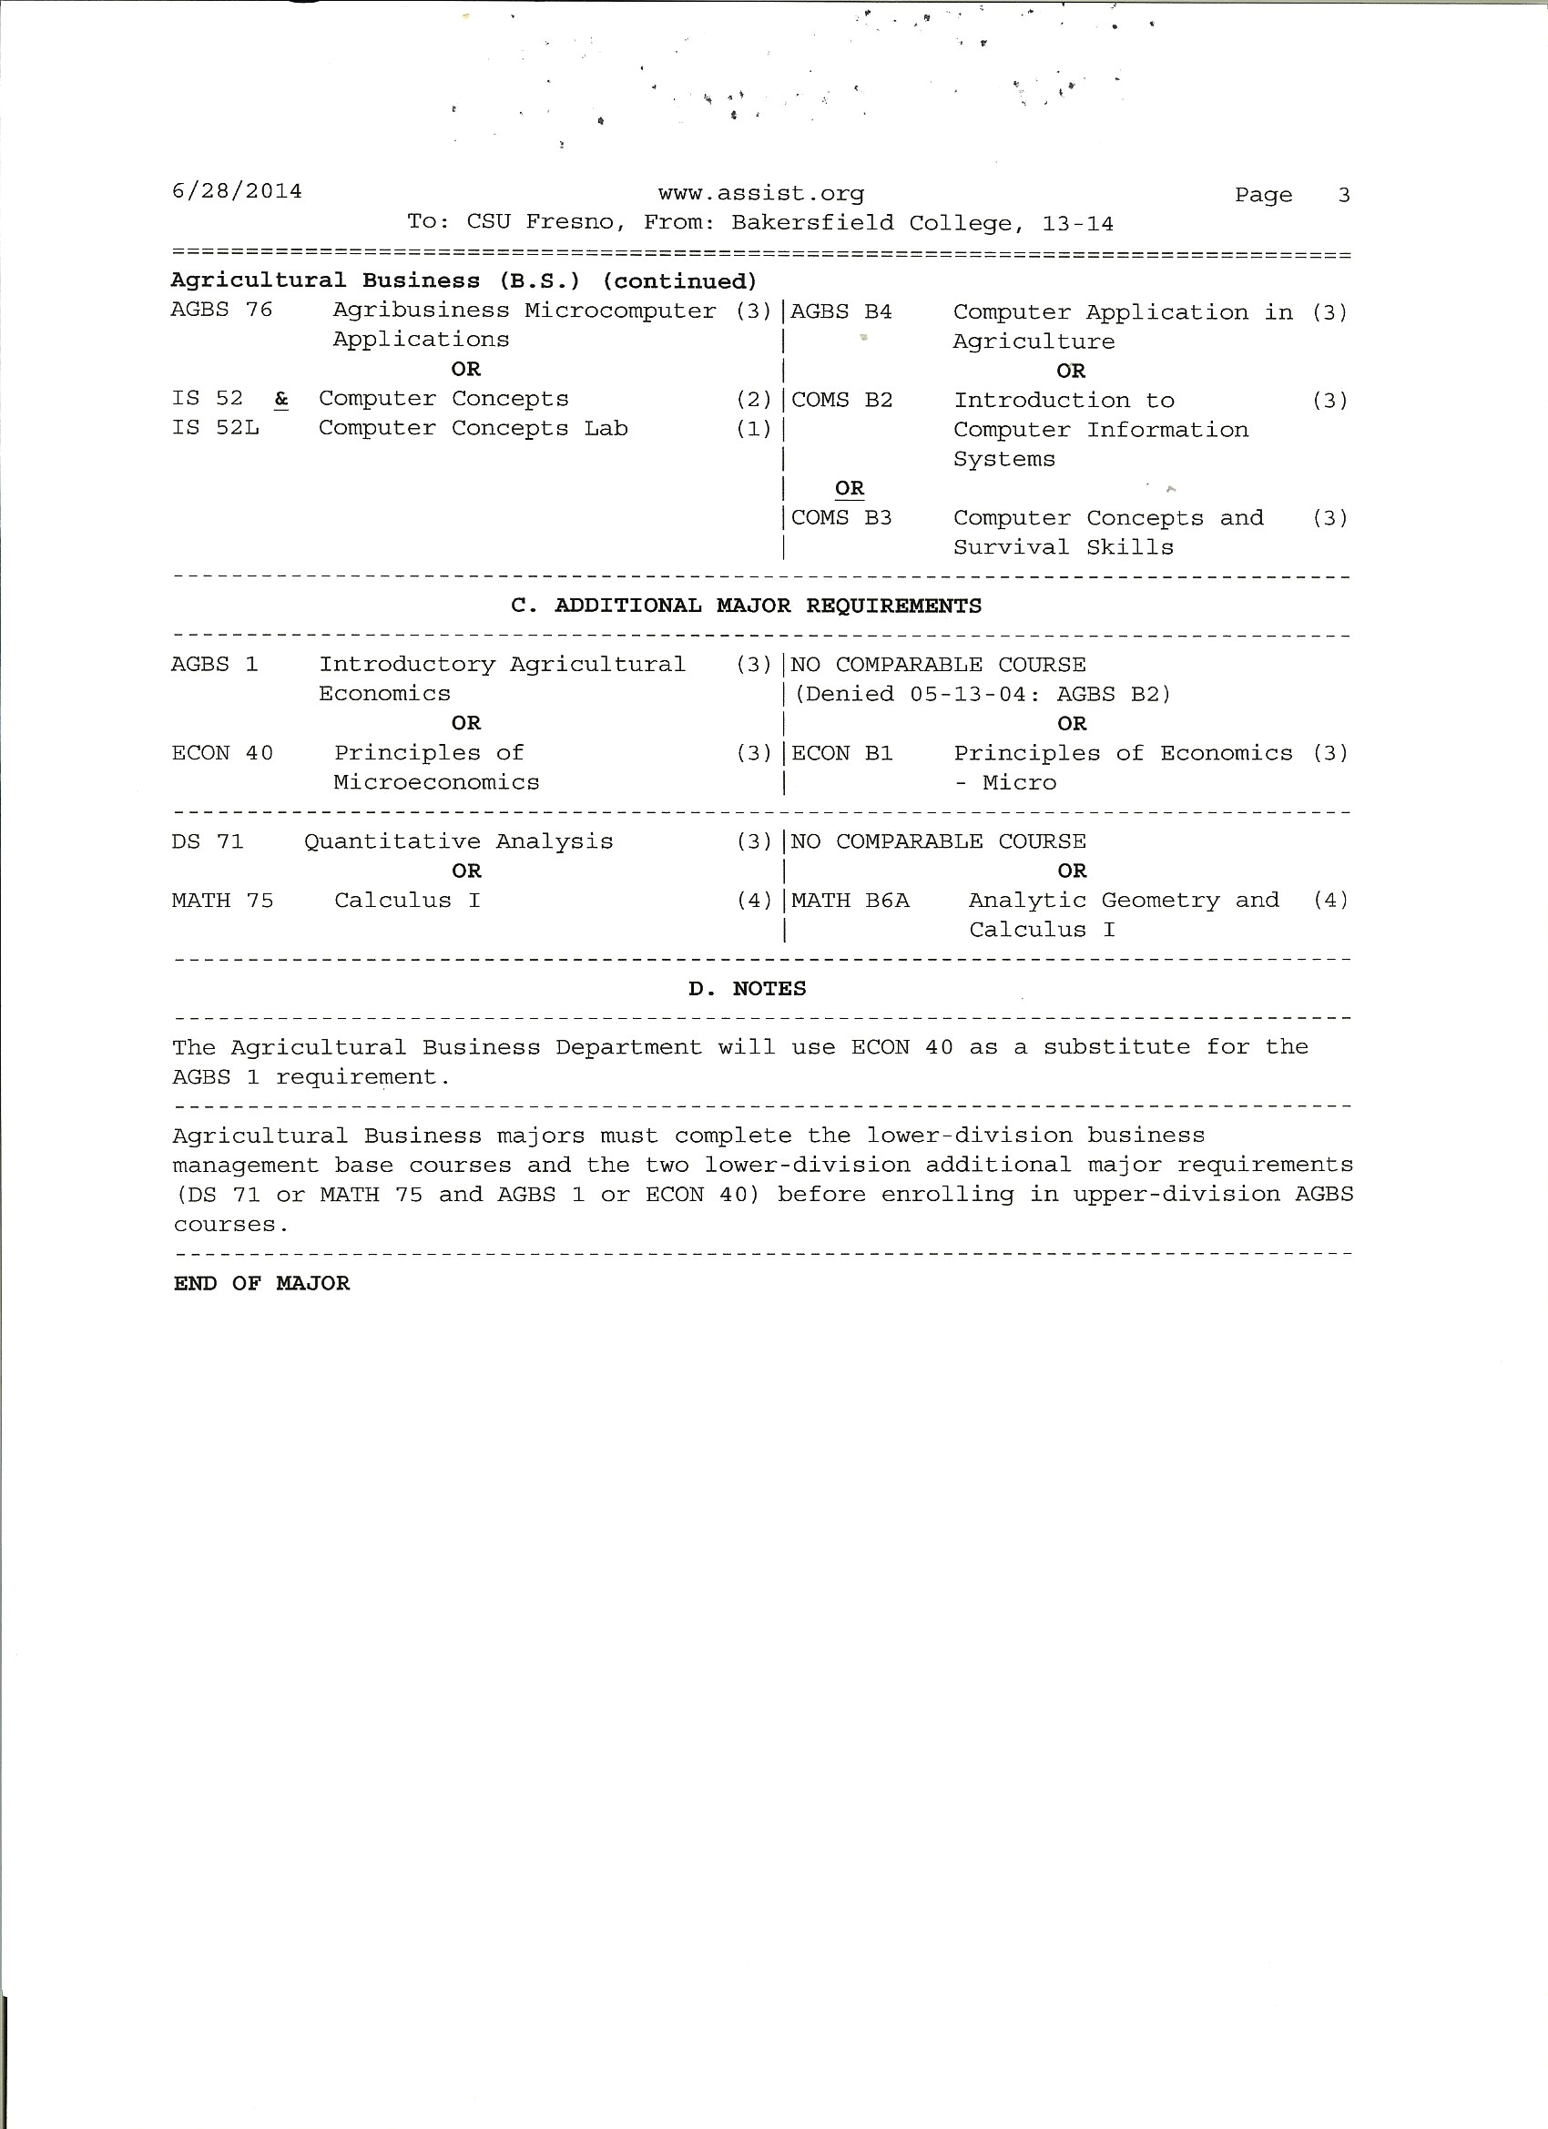
Using assist

Slide 17
Section 1
Section 1 contains lower division courses for your major that are equivalent to BC courses

Slide 18
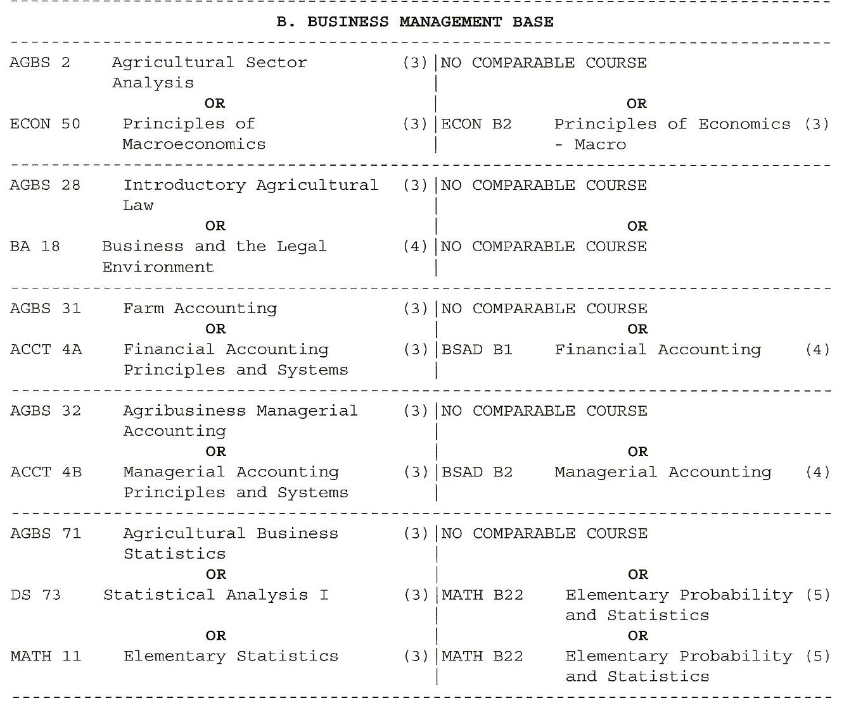
Section 2
Section 2 contains concentrations in your major

Slide 19
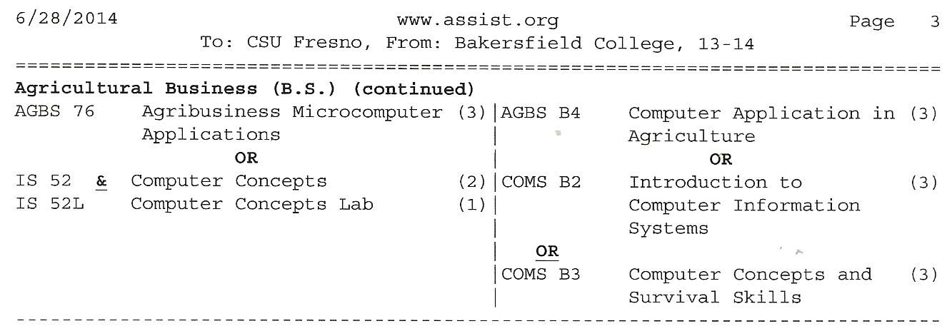
Section 3
Section 3 contains

Slide 20
Section 4
Section 4 contains additional courses

Slide 21
Section 5
Section 5 contains important information

Slide 22
CSU Transfer
Use the CSU general education pattern

Slide 23
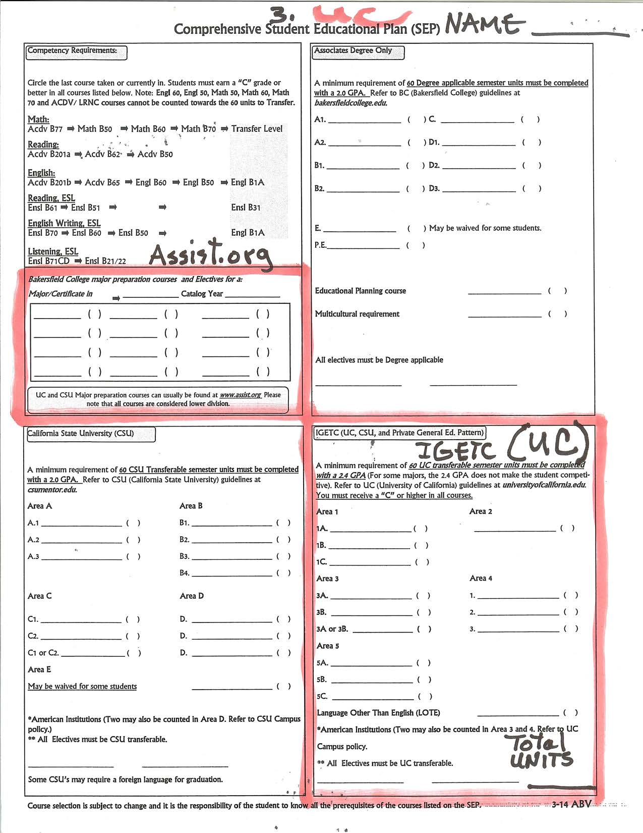
UC Transfer

Slide 24
UC Transfer Blocks
Assist
IGETC
Intersegmental general education certification

Slide 25
ASSIST.org
UC major requirements

Slide 26
IGETC
Use the UC (IGETC) general education pattern
You may find the IGETC in the catalog
Make sure to total your units

Slide 27
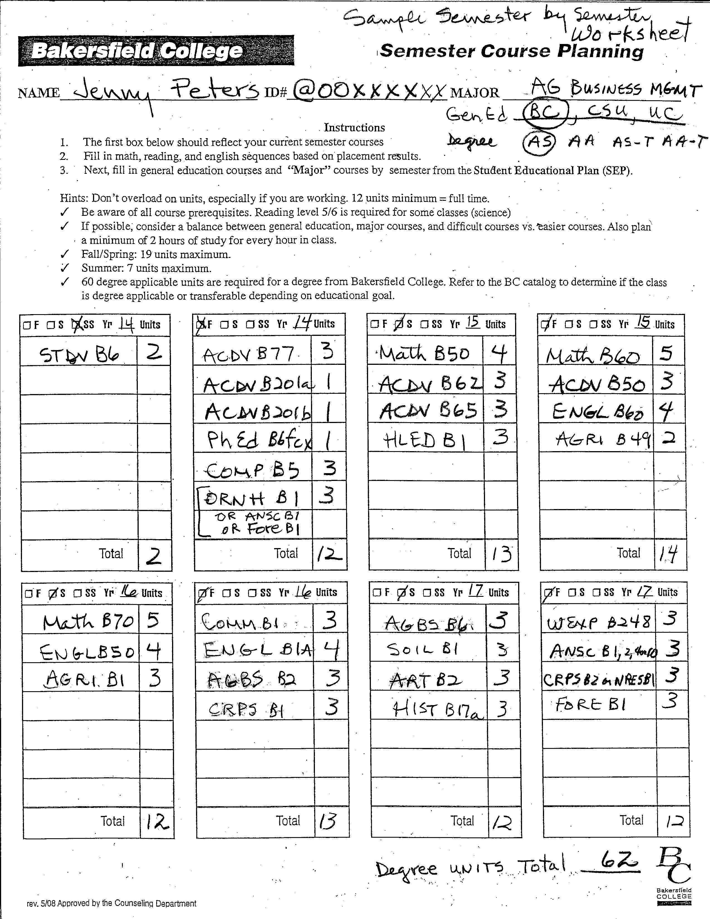
Semester by Semester Worksheet is for your use before writing the final plan on your SEP

Slide 28
Your information
Make sure to add Gen Ed and Degree

Slide 29
Semester Plans
Planning Classes – Close ups follow if this is not adequate on screen.

Slide 30
Semester plans
Second line of plan

Slide 31
First two semesters
Transferable units are numbered 1-49

Slide 32
Semester by semester
Math B50 must be completed with a “C” or better to advance to Math B60.
LRNC are twice as fast

Slide 33
Semester by semester
Notice English, reading and math progression
Read prerequisites for required classes

Slide 34
Semester By semester
OR: means you have a choice

Slide 35
Total Your Units
Make sure to add up all of the units and put the total at the bottom.
Transfer and/or degrees require 60 applicable units.

Slide 36
Are there Any questions?

